Slide 1

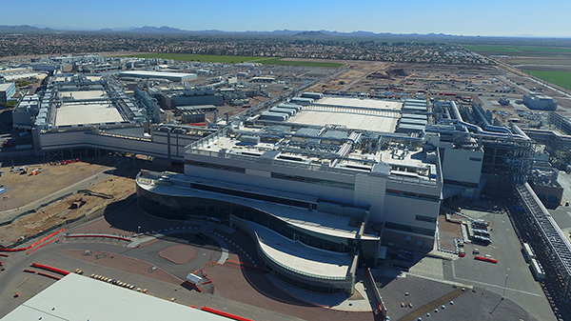

LOCATION SCOUTING FOR A SEMICONDUCTOR FABRICATION PLANT

Slide 2
Geographical Positioning
PLEASE, INSERT HERE A MAP OF ITALY INDICATING WITH A DIFFERENT COLOUR YOUR REGION
PLEASE INSERT HERE A MAP OF YOUR REGION USING THE RED CIRCLE TO INDICATE THE SELECTED AREA AND THE CLOSEST
INTERNATIONAL AIRPORT

Slide 3
Selected area
PLEASE INSERT AN AEREAL VIEW OF THE SELECTED PLOT THAT INCLUDES THE CLOSEST INTERNATIONAL AIRPORT

Slide 4
Selected area
PLEASE INSERT AN AEREAL VIEW OF THE SELECTED PLOT WITH A CLEAR AREA BOUNDARY

Slide 5
Selected area: administrative focus
PLEASE DESCRIBE THE CURRENT STATUS OF THE AREA AND IN PARTICULAR:
- TOTAL AREA IN SQUARE METERS
- MUNICIPALITY/MUNICIPALITIES INVOLVED
- TOTAL OR PREVALENT LAND URBAN DESTINATION (se l’area non è tutta a destinazione industriale indicare le altre attuali destinazioni e il loro valore in mq)
- URBAN DEVELOPMENT AGREEMENTS (specificare se le aree sono già soggette a convenzioni urbanistiche)
- BUILDINGS ALREADY PRESENT IN THE AREA, IF ANY
- REGIONAL INCENTIVE SCHEMES APPLICABLE TO THE AREA

Slide 6
Basic land data
Land details
Type of land | Specify if the area is flat
Buildable land area | Percentage on the total area
Clear Heights for the buildings | Maximum allowed height
Accessibility
Distance from the closest international airport | Km
Dsitance from the closest highway | Km
Distance from the closest commercial port | Km
Distance from the closest city | Km
Distance from the closest town or small urban centers | Km

Slide 7
Utilities and risks
Utilities
Natural gas supply | Cubic meters/day availability
Power availability – Distance from the high voltage | Km
Broadband | Indicate if present or how far from the selected area
Natural hazards
Seismic risk | Insert the class of the area
Meteo-hydro risk | Insert the attention level

